Slide 1

Using Big Data To Solve
Economic and Social Problems
Professor Raj Chetty
Head Section Leader Rebecca Toseland
Photo Credit: Florida Atlantic University

Slide 2
Effects of Class Size: Quasi-Experimental Evidence
How does the number of students in a classroom affect children’s earnings?
STAR experiment: insufficient data to estimate impacts of class size on earnings precisely
Fredriksson et al. (2013) use administrative data from Sweden to obtain more precise estimates
  No experiment here; instead use a quasi-experimental method: regression discontinuity

Slide 3
Regression Discontinuity Using Class Size Cutoffs
Sweden imposes a maximum class size of 25 students
  School that has 26 students in a given grade will therefore have two classes of 13 students each
  School that has 25 students may have one class of 25 students
School that have 26 students in a grade are likely to be comparable to those that have 25 students
  Can identify causal effects of class size by comparing outcomes in schools with 26 vs. 25 students in a given grade

Slide 4
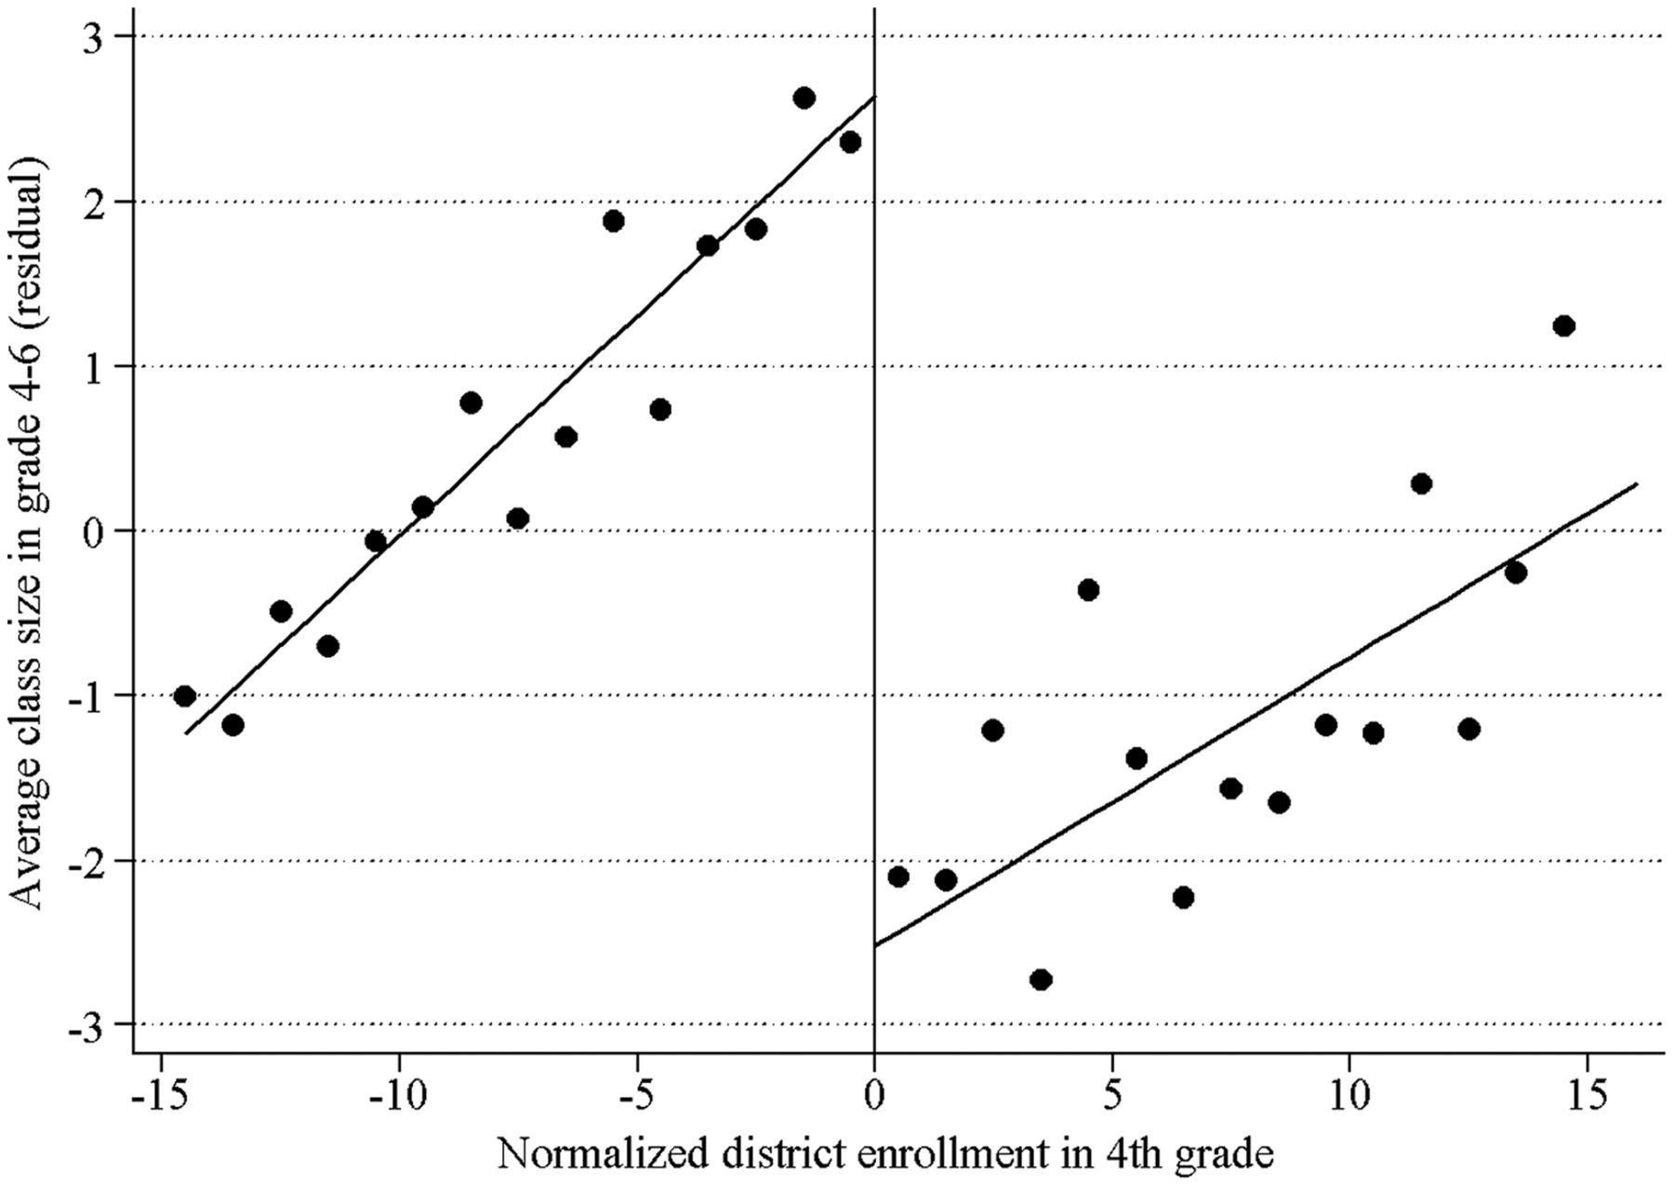
Discontinuities in Class Size Created by Maximum Class Size Rule

Slide 5
Discontinuities in Class Size Created by Maximum Class Size Rule
Maximum class size
cutoff (25 students)

Slide 6
Discontinuities in Class Size Created by Maximum Class Size Rule
Num. of Students in School
Relative to Cutoff

Slide 7
Discontinuities in Class Size Created by Maximum Class Size Rule
Average Class
Size

Slide 8
Discontinuities in Class Size Created by Maximum Class Size Rule
Class size falls by 5
Students when school
crosses threshold

Slide 9
Regression Discontinuity Methods
Recall that any quasi-experimental approach requires an “identification assumption” to make it as good as an experiment
For regression discontinuity (RD), the assumption is that other student characteristics do not jump discontinuously at cutoff point
  Suppose everything else (parents, students’ abilities, etc.) changes continuously (smoothly) with size of the school
  Then the only discrete change at the max size cutoff is the size of the class
  This makes groups above and below the cutoff comparable → like an experimental comparison

Slide 10
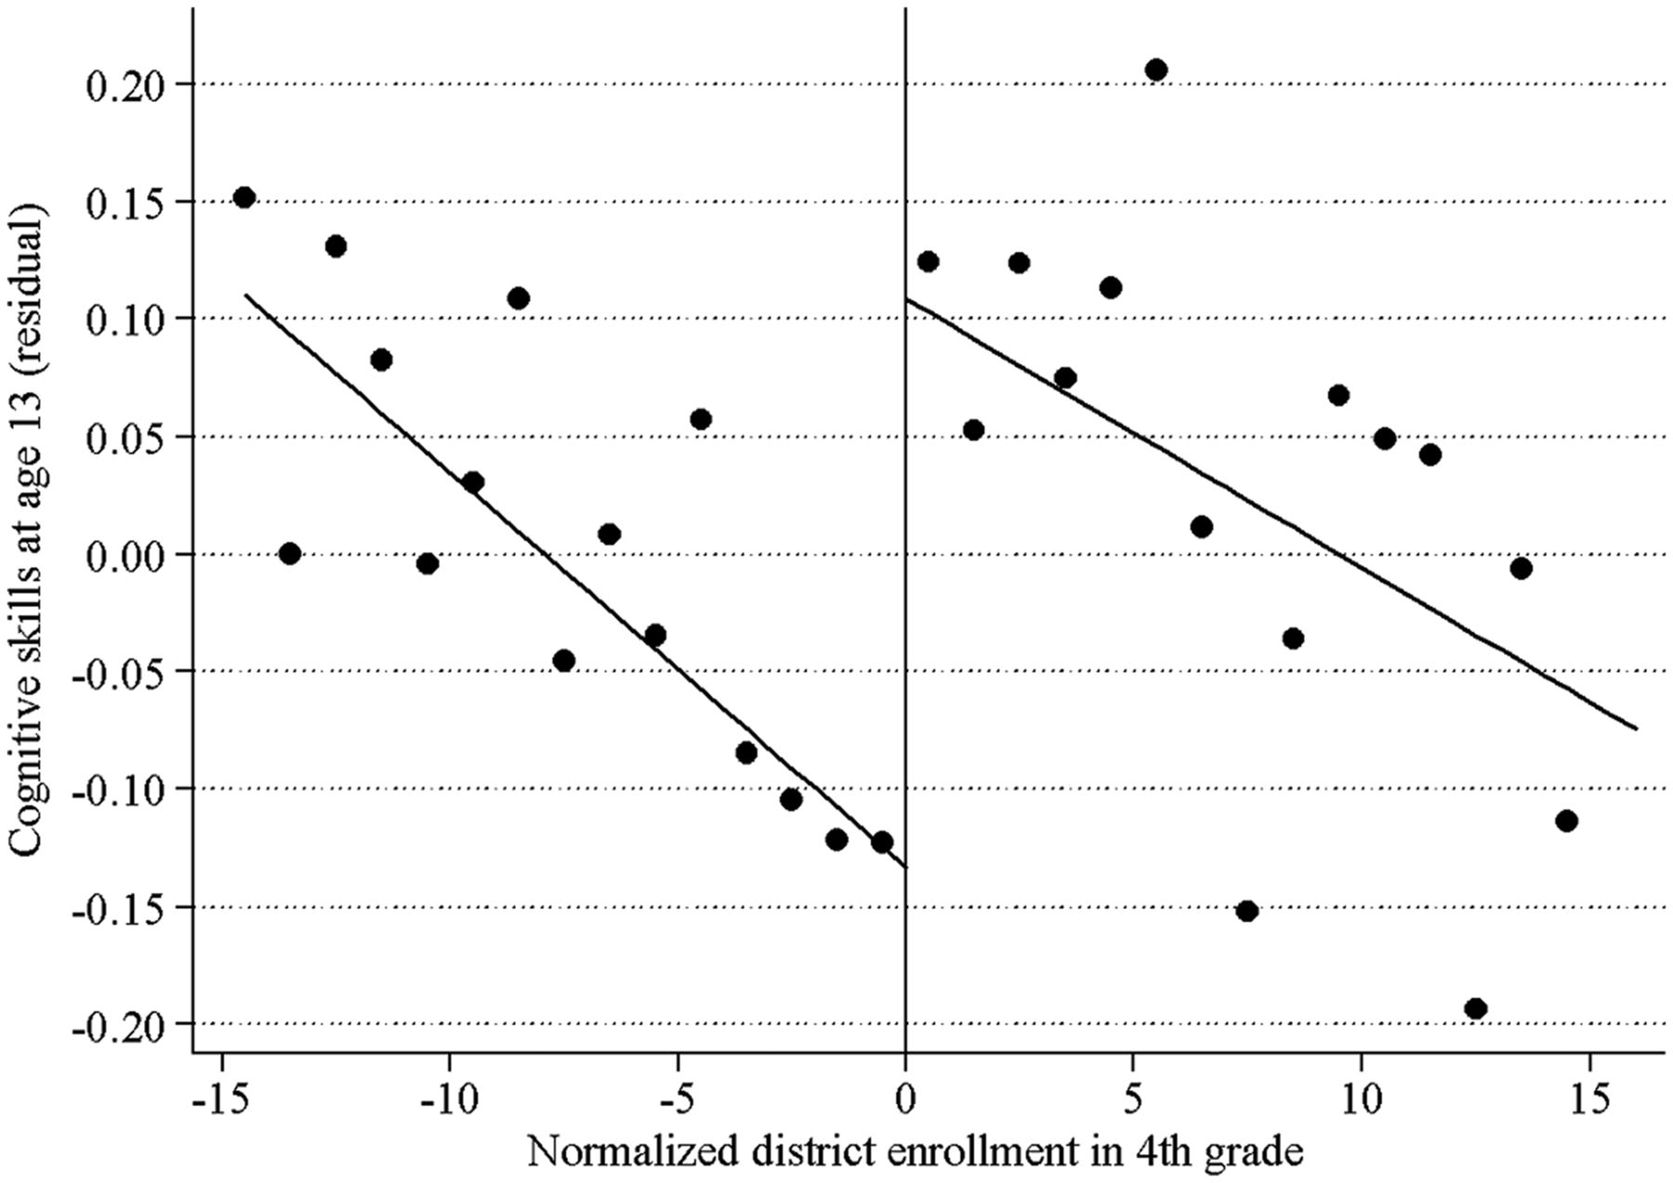
Test Score Achievement: Regression Discontinuity Estimates

Slide 11
Test Score Achievement: Regression Discontinuity Estimates
Test scores jump by 0.2 standard deviations (8 percentiles) at cutoff
→ Reducing class size by 5 students causes 8 percentile increase in scores

Slide 12
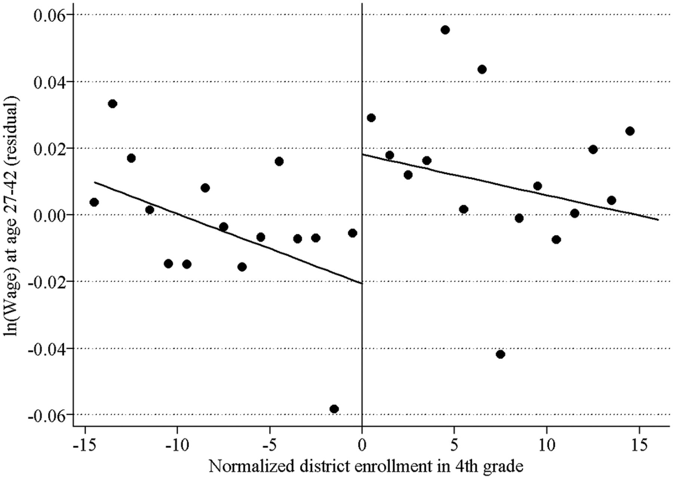
Earnings Impacts: Regression Discontinuity Estimates
Earnings jump by 0.04 log points (4 percent) at cutoff
→ Reducing class size by 5 students causes 4% increase in earnings

Slide 13
Lessons on Class Size
Reducing class sizes in primary school by hiring more teachers can have large returns
  Present value of lifetime earnings of a child growing up in a family at 25th percentile is about $500,000 on average
  4% earnings gain from smaller class = $20,000
  Dividing a class of 30 students into two would increase total earnings of students by more than $600,000
  Costs (hiring another teacher and an additional room) likely to be well below $600,000

Slide 14
Teacher Quality
But need to hire new teachers carefully when reducing class sizes…
  Next topic: how does teacher quality affect students’ outcomes?

Slide 15



Using Big Data to Study Teachers’ Impacts
  School district records
  2.5 million children
  18 million test scores
  Tax records
  Earnings, College Attendance, Teen Birth
Source: Chetty, Friedman, Rockoff: “Measuring the Impacts of Teachers I and II” AER 2014

Slide 16

Measuring Teacher Quality: Test-Score Based Metrics
  One prominent measure of teacher quality: teacher value-added
  How much does a teacher raise her/his students’ test scores on average?

Slide 17
Debate About Teacher Value-Added Measures
Controversial and highly politicized debate about using teacher value-added (VA) measures to evaluate teachers
At its core, debate revolves around three statistical issues:
  Potential for bias in VA estimates
    Do differences in test-score gains across teachers capture causal impacts of teachers or are they driven by student sorting?

Slide 18
Debate About Teacher Value-Added Measures
Controversial and highly politicized debate about using teacher value-added (VA) measures to evaluate teachers
At its core, debate revolves around three statistical issues:
  Potential for bias in VA estimates
  Lack of evidence on teachers’ long-term impacts
    Do teachers who raise test scores improve students’ long-term outcomes or are they simply better at teaching to the test?

Slide 19
Debate About Teacher Value-Added Measures
Controversial and highly politicized debate about using teacher value-added (VA) measures to evaluate teachers
At its core, debate revolves around three statistical issues:
  Potential for bias in VA estimates
  Lack of evidence on teachers’ long-term impacts
  Instability of VA estimates
    Are estimates of teacher quality based on a few years of data too unstable to be useful for policy?

Slide 20
Measuring the Impacts of Teachers
Ideal experiment to answer these questions: randomly assign students to teachers with different value-added
Test whether those with high value-added teachers have higher test scores and earnings
We use a quasi-experimental approximation to this experiment
  Exploit the fact that there is a lot of turnover in teachers across school years
  When high VA teachers arrive at new schools, do scores go up?

Slide 21

A Quasi-Experiment: Entry of High Value-Added Teacher
56
Entry of Teacher
with VA in top 5%
54
Average Test Score
52
50
‘93
‘94
‘95
‘96
‘97
‘98
School Year
Scores in 4th Grade
Scores in 3rd Grade

Slide 22

A Quasi-Experiment: Entry of Low Value-Added Teacher
55
Entry of Teacher
with VA in bottom 5%
54
53
Average Test Score
52
51
50
‘93
‘94
‘95
‘96
‘97
‘98
School Year
Scores in 4th Grade
Scores in 3rd Grade

Slide 23
Lesson 1: VA Estimates Are Unbiased Measures of Teacher Effectiveness
Students assigned to higher value-added teachers have higher test scores
  Being assigned to a teacher who is predicted to raise test scores by 10 percentiles increases a given student’s score by ~10 percentiles
  Differences in VA measures largely capture causal effects of teachers, not differences in types of students they are assigned (selection)

Slide 24

Effect of Teacher Quality on College Attendance Rates
38.5%
38.0%
37.5%
Attending College at Age 20
37.0%
36.5%
36.0%
5th
Median
95th
Teacher Quality (Value-Added) Percentile

Slide 25

Effect of Teacher Quality on Earnings
$22.0K
$21.5K
Earnings at Age 28
$21.0K
$20.5K
5th
Median
95th
Teacher Quality (Value-Added) Percentile

Slide 26

Effect on Teacher Quality on Teenage Birth Rates
14.5%
14.0%
13.5%
Women with Teenage Births
13.0%
12.5%
5th
Median
95th
Teacher Quality (Value-Added) Percentile

Slide 27
Lesson 2: VA Estimates Based on Test Scores
Predict Teachers’ Long-Term Impacts
Assigning a student to a higher value-added teacher raises not just test scores but long-term outcomes
  Teachers who generate high test scores are not just “teaching to the test”

Slide 28
The Value of Improving Teacher Quality
5th
Median
95th
Teacher Quality (Value-Added) Percentile

Slide 29
The Value of Improving Teacher Quality
+$80,000 lifetime earnings per child
= $2.2 million per classroom of 28 students
= $407,000 in present value at 5% int. rate
5th
Median
95th
Teacher Quality (Value-Added) Percentile

Slide 30
Reliability of Teacher Value-Added Estimates
Previous calculation overstates feasible gain because we do not observe each teacher’s value-added perfectly
In practice, we usually have performance data for just a couple of years before we need to make personnel decisions
  VA estimates based on a couple of classes are statistically imprecise
  Teachers who happen to have students who do well by chance will get a high VA score
Does this estimation error in VA reduce gains from previous exercise?

Slide 31
Selecting Teachers on the Basis of Value-Added Estimates
0.04
0.03
Density
0.02
0.01
0
0
-0.3
-0.2
-0.1
0
0.1
0.2
0.3
Teacher’s Actual Effect on Test Scores
True VA

Slide 32
Selecting Teachers on the Basis of Value-Added Estimates
0.04
0.03
Density
0.02
0.01
0
0
-0.3
-0.2
-0.1
0
0.1
0.2
0.3
Teacher’s Actual Effect on Test Scores
True VA
Estimated VA Below 5th Percentile After 3 Years

Slide 33
Earnings Gain from Teacher Replacement Based on Estimated VA
Gain from Deselection on True VA = $407,000
400
300
Lifetime Earnings Gain Per Class ($1000s)
200
100
0
0
2
4
6
8
10
Number of Years Used to Estimate VA

Slide 34
Lesson 3: VA Estimates Based on a Few Years of Data Are
Sufficiently Reliable to Generate Large Gains on Average
VA estimates do fluctuate depend upon which students teachers get
But even taking this into account, gains from replacing teacher with estimated VA in bottom 5% with teacher of average quality is $250,000
  Less than $400,000 gain we’d achieve if there were no measurement error in VA, but still substantial

Slide 35
Relevance of Findings to Current Policy Debate
Most school districts in the U.S. do not use any performance metrics to evaluate teachers
  In many districts, 98%+ of teachers get tenure within 3 years
  Pay set purely based on experience, not performance
New evidence on VA metrics has sparked interest in changing this system

Slide 36


Policy Impacts
“We know a good teacher can increase the lifetime income of a classroom by over $250,000.... Every person in this chamber can point to a teacher who changed the trajectory of their lives”
- Barack Obama, State of the Union, 2012
“A recent study by Harvard and Columbia economists found that students with effective teachers are less likely to become pregnant, more likely to go to college and more likely to get higher-paying jobs....Ineffective teachers are hurting our students’ futures – we can’t allow that.”
- Michael Bloomberg, State of the City, 2012

Slide 37

Policy Impacts

Slide 38
Summary: Improving Public Schools
New data show that changing public schools in certain specific ways can have large long-term returns
Reducing class size can be very valuable
  But critical to hire highly effective new teachers when doing so
There are large, measurable differences in teacher quality,
  We should do more to attract and retain top teachers in public schools (not just using value-added metrics but also other tools)

Slide 39
Marked-Based Solutions: Charter Schools

Slide 40
Market-Based Solutions to Improving Education
Alternative approach to improving education: leverage market forces
Permit school choice → best schools will attract more students and other schools will improve their performance to stay in business
Two ways we currently take such an approach in the U.S.
  Charter schools: schools that are publicly funded but independent of public school system
  Vouchers that students can use for private schools instead of their local public school

Slide 41
Do Charter Schools Work?
Question: are private schools/charter schools better than public schools?
Cannot simply compare outcomes at charters and public schools
  Charters tend to be concentrated in lower-income, urban areas → outcomes worse on average

Slide 42
Do Charter Schools Work?
Several recent studies estimate effects of charter schools on students’ outcomes by exploiting lotteries for admission
  Charter schools often have more applicants than seats → use lotteries to assign seats
  Comparing outcomes of winners vs. losers identifies causal effects
References:
    Abdulkadiroǧlu, Angrist, Dynarski, Kane, Pathak. “Accountability and Flexibility in Public Schools: Evidence from Boston’s Charters and Pilots.” QJE 2011.
    Chabrier, Cohodes, Oreopoulous. “What Can We Learn From Charter School Lotteries?” JEP 2016

Slide 43
Effects of Boston Area Charter Schools
Abdulkadiroglu et al. (2011): compare effects of charter schools and pilot schools in Boston
  Charter schools are exempt from all public school regulations
  Pilot schools are like charters but covered by Boston Public School regulations and teachers union contracts
  Both are financed by payments from students' home district: tax payments transferred to charter/pilot school

Slide 44
Effects of Boston Charter and Pilot Schools on Test Scores
Charter Schools
Pilot Schools
0.6
0.4
Causal Effect on Test Scores (Std. Dev.)
0.2
0.0
-0.2
English
Math
English
Math

Slide 45
Effects of Boston Area Charter Schools
Subsequent study by Angrist et al. (2013) shows that Boston charters have significant effects on college attendance rates
Lesson: charters generate positive effects on average; pilots are no better than public schools
  Suggests that the flexibility obtained by relaxing public school restrictions (e.g., on teacher hiring) is a key driver of positive impacts

Slide 46
Effects of Charter Schools: Summary
Chabrier et al. (2016) summarize literature on charter schools
  Small positive mean effects on test scores on average
  In general, “no excuses" schools (extra hours, discipline, academic focus) tend to have positive impacts

Slide 47
Market Competition and Charter Schools
Does market discipline lead to growth of better schools and improvement in performance over time?
Baude, Casey, Hanushek, and Rivkin (2014) study how quality of charter schools in Texas changed over time
Difficult to estimate causal effect of 500 schools using lotteries
Instead calculate value-added of each school by estimating average test score gains in each school
Compare distributions of school value-added for charters relative to Texas Public Schools over time

Slide 48
Distribution of School Math VA by Year: Texas Charters vs. Public Schools
Source: Baude et. al. 2014

Slide 49
Market Share of “No Excuses" Charter Schools in Texas
Source: Baude et. al. 2014

Slide 50
Market Competition and Charter Schools
Charter school market is evolving in a positive direction
  Better schools gaining enrollment over time
  But still a number of relatively low-performing schools, even many years after system began

Slide 51
Limitations of Market Competition
Three limitations of relying purely on private market competition
  Markets may function poorly when quality is not well observed
    Difficult to gauge value-added, especially when outcomes (e.g. college, earnings) are realized 10+ years after treatment

Slide 52
Limitations of Market Competition
Three limitations of relying purely on private market competition
  Markets may function poorly when quality is not well observed
  Cream skimming of students and teachers
    Private schools have an incentive to reject less qualified applicants
    Can exacerbate inequality by leaving less qualified students behind in schools with fewer resources and weaker peers

Slide 53
Limitations of Market Competition
Three limitations of relying purely on private market competition
  Markets may function poorly when quality is not well observed
  Cream skimming of students and teachers
  Parents may not make well-informed choices
    Hastings, Kane, and Staiger (2007) study introduction of school choice in Charlotte, NC in 2002
    Low income parents are much less likely to choose schools with high test scores than high income parents
    School choice can amplify achievement gaps

Slide 54
Improving Education: Summary
We now have simple, empirically proven ways to improve primary education
  Solutions range across political spectrum: more resources to reduce class size in public schools to expansion of “no excuses” charter schools
Which approach is better: government or market based?
  Current constraints in public school system (local property tax funding base, regulations on teacher hiring) limit its effectiveness
  But unregulated market system likely to deliver highly variable outcomes
Best system may be a hybrid that preserves flexibility within schools while offering uniform quality and resources across schools

